Slide 1

Microsoft Azure DevOps Majdi Saibi May 28th, 2019

Slide 2
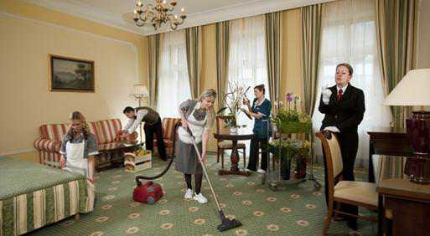
Housekeeping
Introductions
Next Meetup June ???
SQL Server Modern Migration Tour (June 20th)
Wanted: Membership Director
Dev Edmonton Slack channel https://devedmonton.com/
News? Hiring or looking for work?
Notes:
Introduce yourself and other EDMUG executives.
Washrooms.
Next meetup???
Anyone want to be help us out as Membership Director? Help us
Discuss .NET on the Dev Edmonton Slack channel.
News? Anyone hiring or looking for work?

Slide 3



Thanks to Our Sponsors
Are you interested in being a sponsor? Let use know.
Notes:
PSLC new logo and swag.
JetBrains.
Any other sponsors?

Slide 4
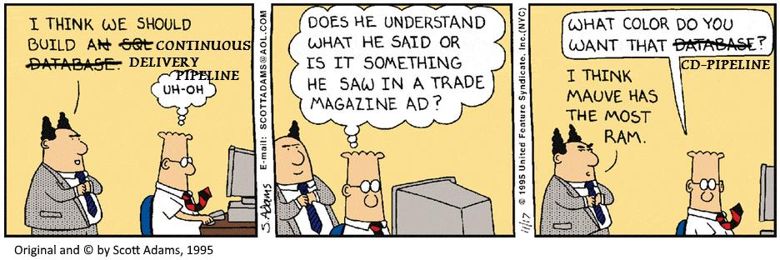
Microsoft Azure DevOps
Majdi Saibi – Riva CRM Integration
Microsoft Student Partner
Notes:
Riva does integration, data sync, and relationships for CRMs and e-mails.
Has been sharing his knowledge with others since he was a Microsoft Student Partner.
Master of Tunisia from University of Monastir with a Computer System Engineering. Tunisia community manager for Microsoft.

Slide 5
Wrap-up
Survey and prize draw! Constructive feedback appreciated.
Next meetup: June ???
Contact: info@edmug.net http://edmug.net
Notes:
Thank the presenter, sponsors, and members.

